Slide 1


WEEK #4
SPRINT #1
PL6
TST

Slide 2


about us.

Slide 3
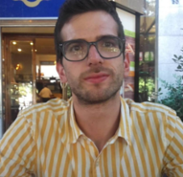
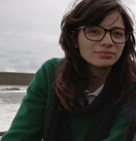
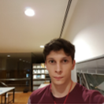
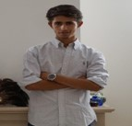
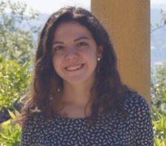
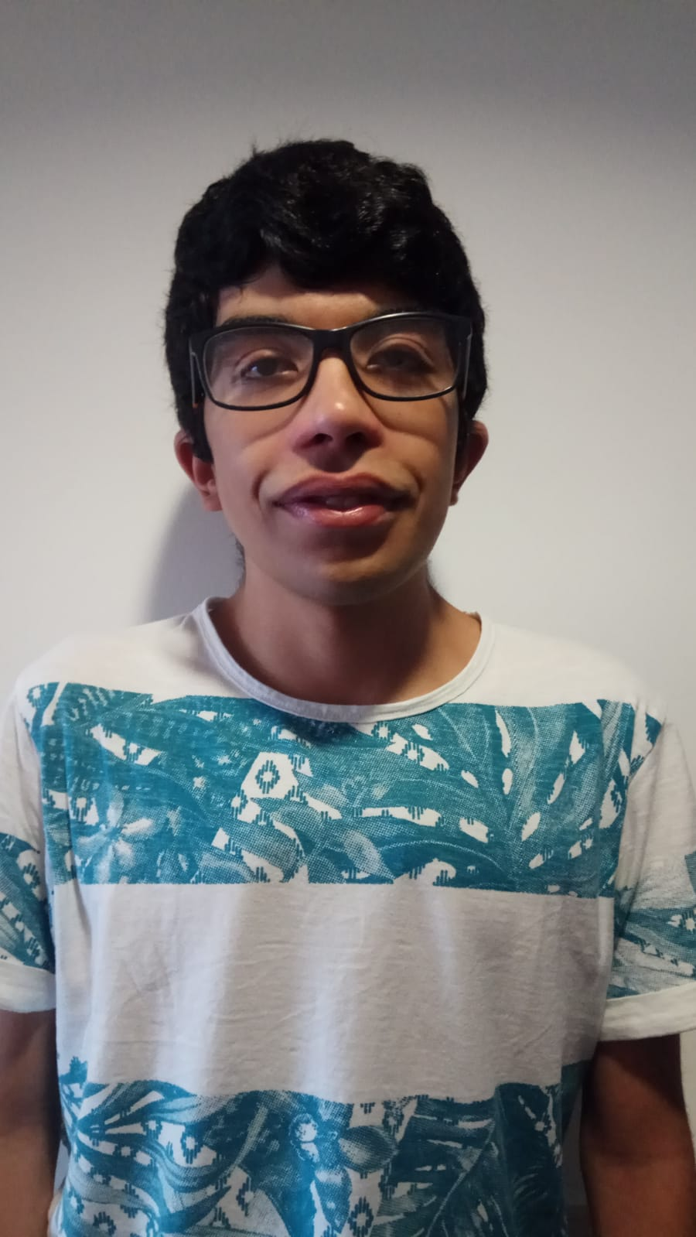
tst.
Carlos Sobral
Ana Teresa
Miguel Diogo
João Tomás
Isabel Carvalho
David Ferrugento

Slide 4
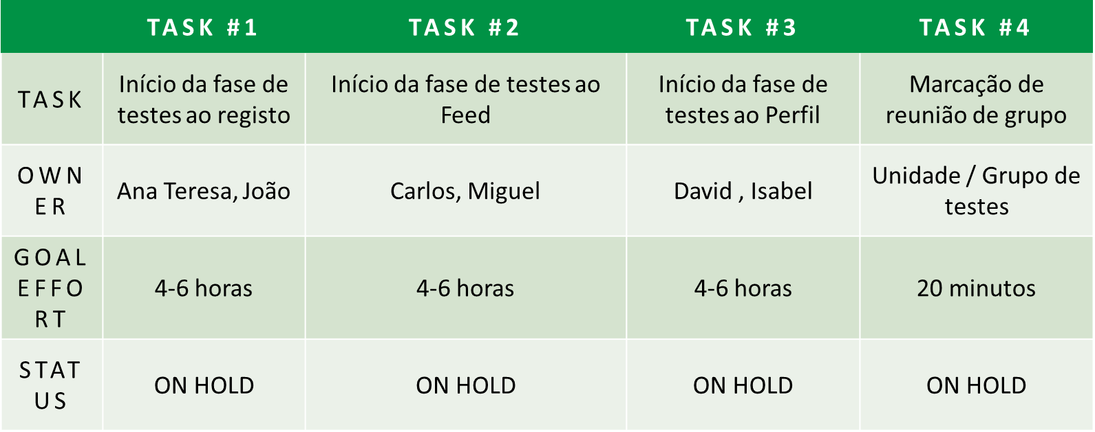
tasks.

Slide 5
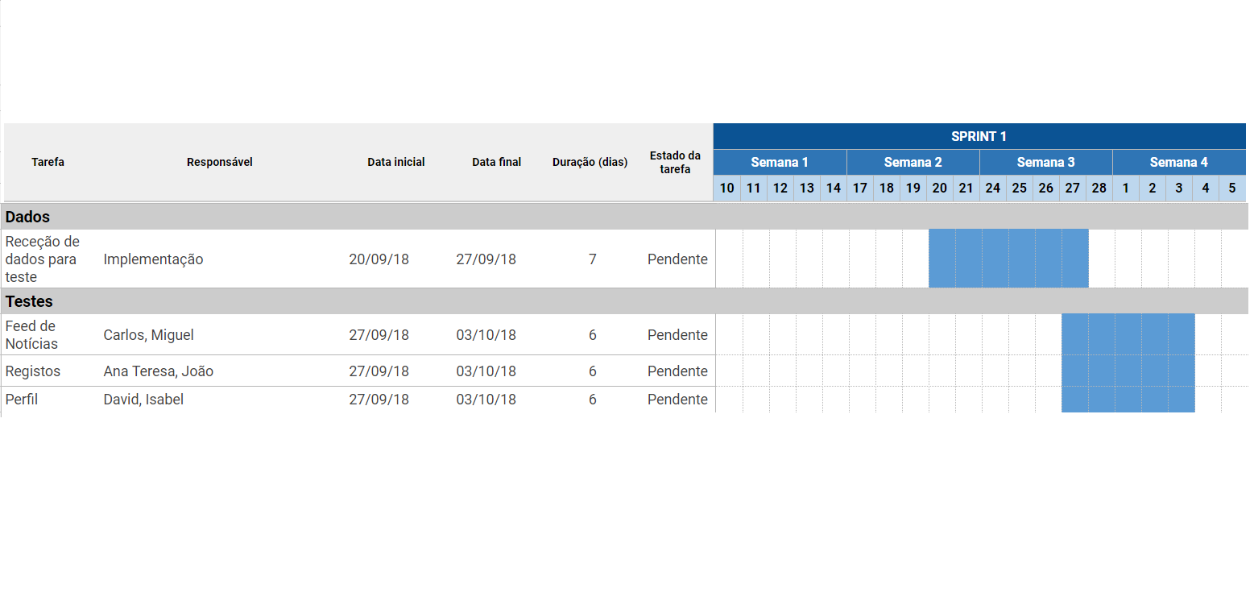
Gantt Diagram.

Slide 6
planned tasks.
 | TASK #1 | TASK #2 | TASK #3 | TASK #4
TASK
OWNER
GOAL EFFORT
STATUS | ON HOLD | ON HOLD | ON HOLD | ON HOLD

Slide 7
Gantt Diagram.

